Slide 1
NRPF Presentation 2023

Slide 2

Introductions:

Slide 3
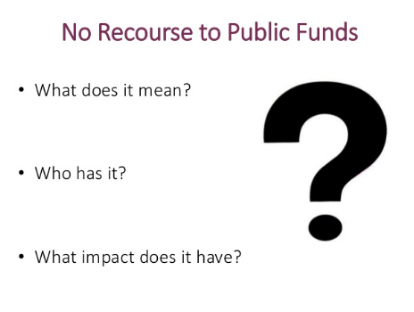

Slide 4
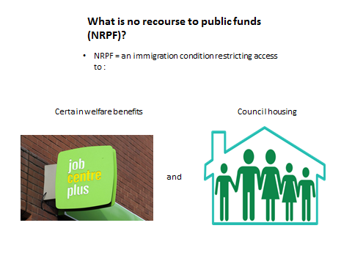

Slide 5
Who has NRPF?
People ‘subject to immigration control’
Visitors Visa
Student Visa
Visa over-stayer and illegal entrants
Limited leave to remain e.g. spouse or family private life. Granted leave to work but not access public funds
Spousal Visa
British Overseas territory passport holder.
EU National who has pre-settled status and are not in employment
Hongkongers or Hong Kongese
Asylum Seekers

Slide 6
Asylum Seekers
The local authority has no duty to provide accommodation and subsistence to Asylum Seekers. Section 95 of the Asylum Act 1999 places this duty on the Home Office, however all above categories are eligible for a Care Act Assessments regardless of their status.

Slide 7
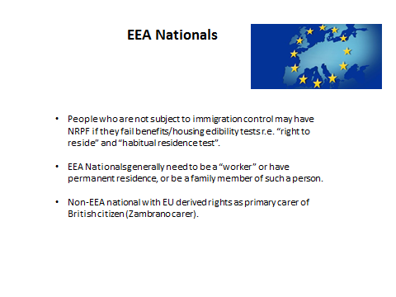
The UK has now left the European Union and free travel from those countries ended on 31/12/2020 and European Nationals now fall into one of the following categories
Permanent Residence
If a person has resided in the UK for over 5 Years, they are then granted full settled status with access to public funds including Housing support. The cut off for these applications was 30/06/2021 but extensions have been allowed in extenuating circumstances.
Pre- Settled Status
If a person had lived in the UK less than 5 years when we left the EU they would be granted Pre-Settled status which would allow them to claim benefits if they were in employment. Otherwise they would be restricted.
All new arrivals to the UK from 01/01/2021 are required to apply for their entry clearance before travelling, whether that be via the tier-based visa system or as a dependant of someone residing in the UK already. They would then fall into one of the earlier mentioned categories.

Slide 8

NHS
NHS treatment is not classed as a public fund for immigration purposes and can be accessed by a person regardless of their immigration status, including a person who is subject to the ‘no recourse to public funds’ (NRPF) condition. However, a person’s immigration status will affect whether they are required to pay for some types of treatment.
Primary NHS healthcare is delivered through GP practices, NHS walk-in center's, dentists, pharmacists and optometrists, and these services can be accessed by everybody for free, regardless of their immigration status. A person may need to pay for prescriptions and dental treatment if none of the exemptions based on age, income or medical conditions apply.
Most types of secondary and community NHS healthcare are chargeable to people who are considered to be ‘overseas visitors’, unless an exemption applies. Most people applying for leave to remain will have had to pay the NHS surcharge (Immigration Health Charge), when they made their application, in order to be exempt from charging for secondary healthcare. When treatment is chargeable to a person, it must be paid for up front, unless the treatment is deemed to be urgent or immediately necessary. Therefore, a person may be denied treatment if they are unable to pay for it.

Slide 9
GP’s
Anyone in England can register and consult with a GP without charge
GP practices are not required to ask for proof of identity, address or immigration status from patients wishing to register. NHS guidance on how to register with a GP surgery clearly outlines that a practice cannot refuse a patient because they do not have proof of address or immigration status.

Slide 10
Nil Recourse To Public Funds Team
The NRPF Team is a Social Care Team that sits within adults’ Services.
The Team structure is 1 Service Development Lead, 1 Manager, 1 Deputy Team Manager, 4 Social Workers, 1 Social Work Apprentice, 2 Business Support officers.
The social workers are from mixed backgrounds including adult services, children services, mental health services, law and ex-offenders services.

Slide 11
What does NRPF mean for social services?
Care Act 2014- The NRPF Team have a duty to assess people who have care needs and also have no access to public funds. Included in this is Mental Health, Learning Disability, Physical Disability and older adults.
The Children Act 1989- The NRPF Team has a duty to assess when parents are unable to provide essential needs for their children due to their restricted immigration status. Cases of domestic violence fall within this category.
The Localism Act 2011- The local authority has the powers to provide services when the other criteria are not met. For example, an elderly person with no care needs but homelessness would adversely affect them.

Slide 12
Defining destitution
Section 95 Immigration and Asylum Act 1999
A person is destitute if:
A)They do not have adequate accommodation or any means of obtaining it (whether or not their other essential living needs are met); or
B)They have adequate accommodation or the means of obtaining it, but cannot meet their essential living needs.
There is some flexibility with disabled adults especially if their secure accommodation is unsafe to receive care or equipment relating to them receiving care.
Those who are granted limited leave to remain under the family and private life route or those from Hong Kong if they meet the above criteria can apply to the Home Office to have their conditions changed to allow them access to public funds.

Slide 13
Providing Support
Accommodation (temporary accommodation similar to mainstream services but funded by social care)
Subsistence via prepaid cards
Care and support plan (only traditional care packages, NRPF service users are restricted from Direct Payments)
Advocacy
Signposting

Slide 14
Human Rights Considerations when declining or withdrawing support
Is return practical and reasonable (are there any barriers to them leaving, eg, travel documents or care needs)
Where return is possible is there a breach of Human Rights?
Can the Home Office offer a voluntary returns package?

Slide 15
Referral Process
Consent from individuals is required if you wish to refer as we do contact the Home Office. You can contact us without consent if you wish to have an informal chat.
If you are unsure about someone’s immigration status the team can be contacted via the email address: nilrecourse@royalgreenwich.gov.uk and we can request an update from the Home Office. We need full name, D.O.B and country of origin.
You can also refer for assessment by calling: 0208 921 2304 or by emailing aops.contact.officers@royalgreenwich.gov.uk anyone can refer if they have enough information, otherwise it might be best to request service users to refer themselves directly.

Slide 16
Local Immigration Advice Centres
Plumstead Community Law Centre
36 Wellington Street
Woolwich
SE18 6PE
London
Advice line, 020 8853 9993 Email info@pclc.org.uk
website:http://www.pclc.org.uk/
LEWISHAM REFUGEE AND MIGRANT NETWORK
341 Evelyn Street, London SE8 5QX
Phone: 020 8694 0323
Email: info@lrmn.org.uk
https://www.lrmn.org.uk/

Slide 17
Finding immigration advice
It is unlawful for a person to provide immigration advice when they are not regulated in one of the following ways.
A solicitor regulated by the Law society- recommended that one is selected who has undertaken the immigration and asylum accreditation scheme: http://solicitors. Lawsociety.org.uk/
An adviser registered with the OISC- there are different competency levels e.g. only level 3 advisers can assist with appeals http://home.oisc.gov.uk/howto find a regulated immigration adviser/ adviser finder/finder.aspx
The NRPF Team has no registered advisors.

Slide 18
Useful contacts within NRPF Team
Main Team Number : 0208 921 3398
Email: nilrecourse@royalgreenwich.gov.uk
Additional sources of information:
NRPF Network
https://www.nrpfnetwork.org.uk/
The network was set up by Islington Council and they have collated resources relating to NRPF and keep this updated.

