Slide 1

Migrant Hub -
Presentation to GAN

Slide 2
About the Migrant Hub
Drop-in service offering free advice and practical support (inc free hot meals and food parcels) to refugees, asylum seekers and migrants
One of the fixed Greenwich Advice Hubs
Opening hours: 10am-2:30pm every Tuesday, or later if we have funding for activities. Clients are advised to come between 10-11:45am to get f2f housing advice (though callbacks are available); 10-12:45pm to get f2f immigration advice.
Current partners: Plumstead Community Law Centre (2 immigration advisors) and Greenwich Housing Rights (1 housing advisor)

Slide 3
How we work
We operate on a first come, first served basis, but always try to prioritise especially vulnerable clients, for ALL our services
Provided triage support to all clients who attend, identifying issues and checking in on wellbeing and how we can help
Provide a hot meal at every hub to those attending
Some clients also volunteer in our kitchen. Without our volunteers, we would have a far reduced service
As far as possible try to operate ‘no wrong door’ approach

Slide 4
Statistics
We’ve been operational since at least early 2018, if not further back. Our advice service was stripped back but our food support offer grew during the pandemic.
Supported total 558 clients since April 2022 (based on data available). 425 from Dec 2022-Dec 2023
332 clients seen for immigration advice, 232 for housing
917 food parcels distributed
Signposted 88 clients, 60 to specialists, rest due to lack of capacity
Referred 88 clients, including 11 internally to LRMN (other services) and 3 DV cases to HER Centre
Employment advice given to 20 people

Slide 5
Case Outcome | Record Count
HUB. signposted to immigration specialist | 12
HUB. referred to immigration specialist | 22
HUB. referred to Little Village | 4
HUB. referred to LRMN | 11
HUB. referred to IDVA (Her Centre) | 3
HUB. referred to Healthwatch Greenwich | 1
HUB. one-off housing advice | 30
HUB. legal referal | 5
HUB. food parcel | 917
HUB. food bank voucher | 3
HUB. external signposting (other specialism required) | 48
HUB. external signposting (lack of capacity) | 28
HUB. external referral (other specialism required) | 32
HUB. external referral (lack of capacity) | 10
HUB. employment advice given | 20
HUB. better informed about housing rights | 2
HUB. Letter provided (Support, Grant, Free meals etc.) | 6
HUB. Legal rep secured | 1
HUB. Immigration advice provided by partner | 332
HUB. Housing advice provided by partner | 232
HUB. Council Tax | 18
HUB. Assisted with other issues | 80

Slide 6
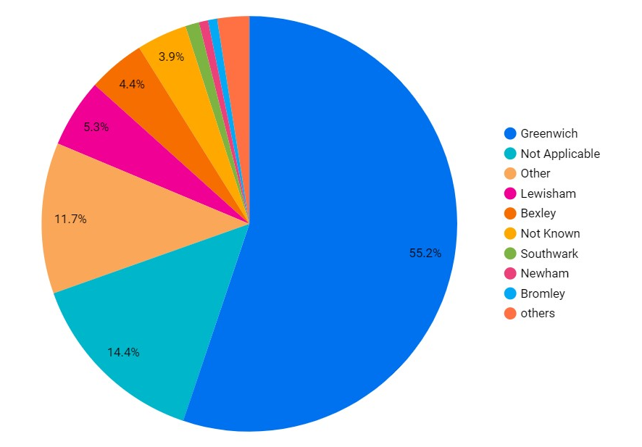
Borough Breakdown

Slide 7
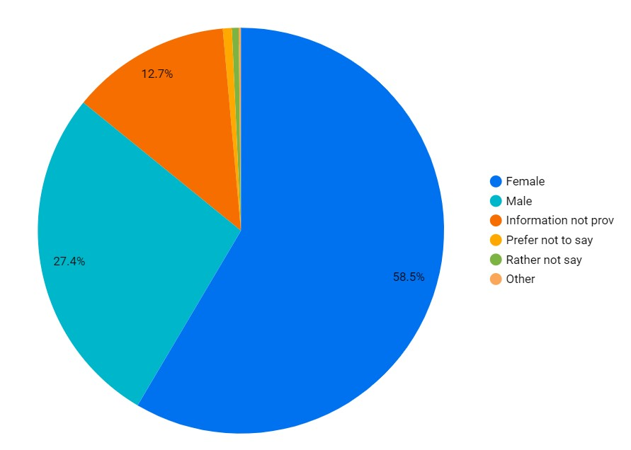
Gender Breakdown

Slide 8
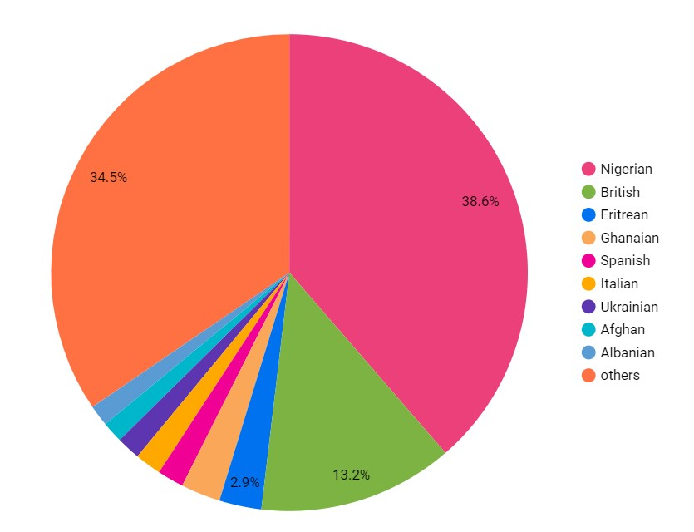
Nationality Breakdown

Slide 9
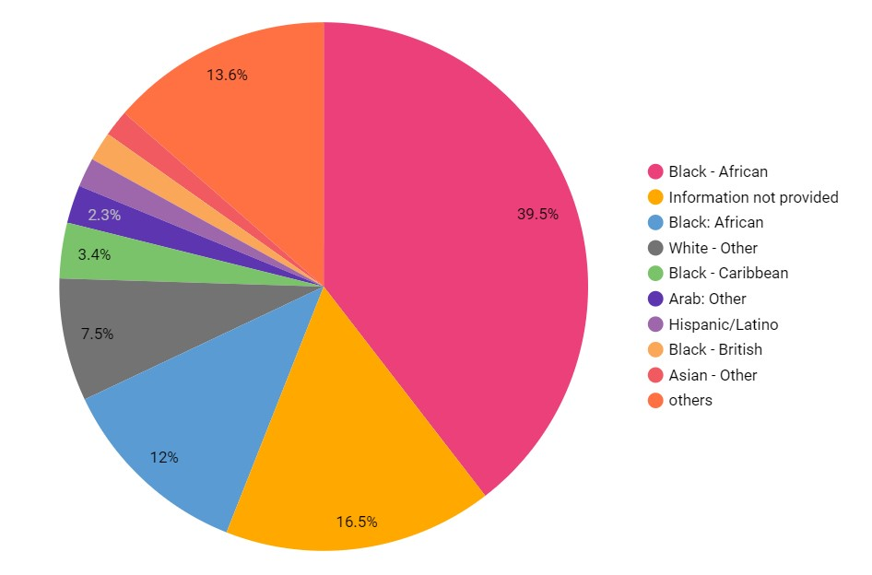
Ethnicity Breakdown

Slide 10
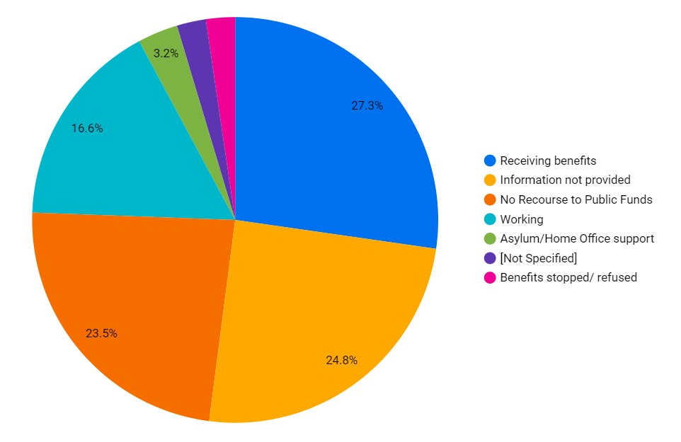
Household income Breakdown

Slide 11
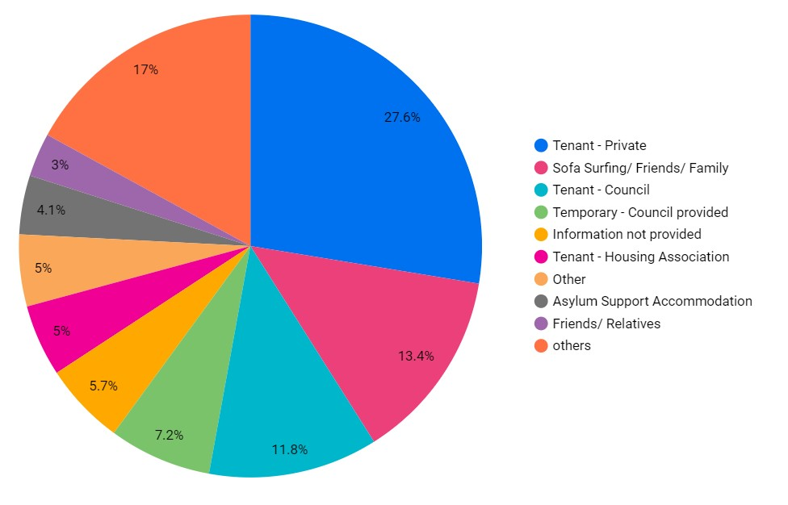
Housing status Breakdown

Slide 12
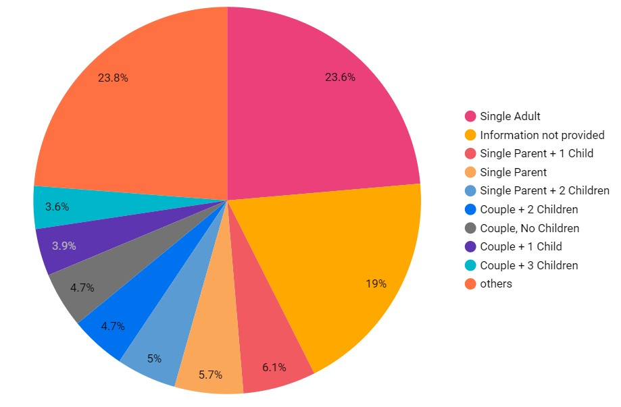
Housing status Breakdown

Slide 13
Additional notes
Majority of clients do not identify as disabled (96%) but this doesn’t mean we don’t frequently see clients with serious / overlapping / chronic physical and mental health issues
Most clients can communicate in at least basic English. Where necessary we use interpreters - recently we have used Arabic, Wolof, Amharic, Tigrinya, French, Spanish. Clients do bring friends/family along to translate too
Rising numbers of people made homeless esp after the 7 day rule. Hardest to help single adult males. We do work with Council officers and use Streetlink to help maximise outcomes

Slide 14
Quotes
"The hub is doing good, great remarks… I'm comfortable here, they take care of us… looking forward to better immigration services"
"they are really good" "people trying their best but we need more" "anytime we have problem, we want it to be solved. not to carry it with us" -
"the migrant hub has been of great help to us, esp for those with nrpf. we are so grateful because theres no way we could have done without their assistance"
Life is hard and deprives one of happiness in the UK. "If you don't have documents people will use you, because they know you can't talk" not free to go out for activities anytime due to restrictions of where I live. "i dont have freedom"
Notes:
citing employment and if we can help get people further along the road to working, as an example.

Slide 15
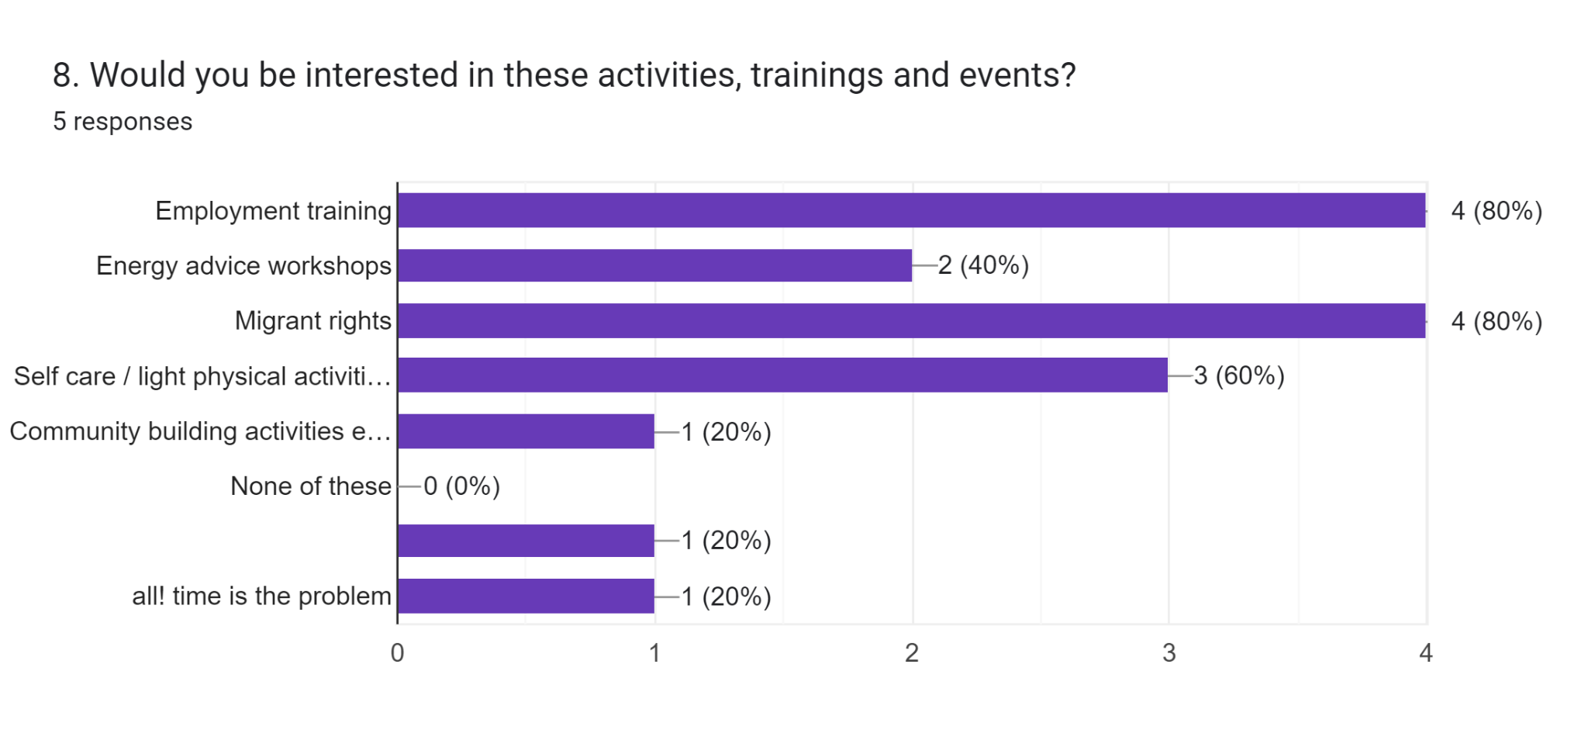
Future directions

Slide 16
Where support needs more resource & reorientation
We work with the most racialised, vulnerable people in our society.
Serious lack of joined-up working in Councils, who do not see lobbying/advocacy to challenge Hostile environment as part of their job
Clients lack trust in support services as well
Charities like LRMN struggling to survive - “Anyone who has ever struggled with poverty knows how extremely expensive it is to be poor.”

